Slide 1

Mexico City Mode comparison
Household Travel Survey Analysis
Zhanchao Yang
2007-2017

Slide 2
Single mode trip
77.59% (2007) vs 86.18% (2017)
Note: In 2017, walking was counted as a separate category. Walking + other modes is counted as “other” modes.
E.g., walking + driving = driving

Slide 3
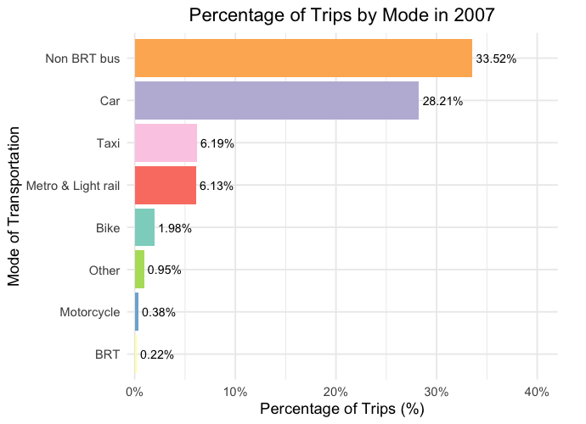
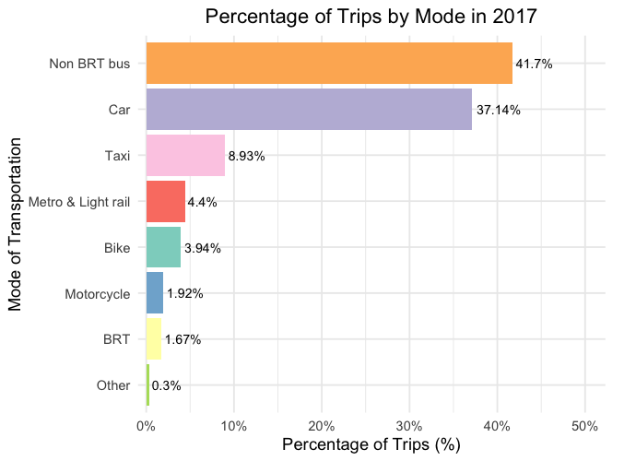
2007 vs 2017 single mode trip distribution

Slide 4
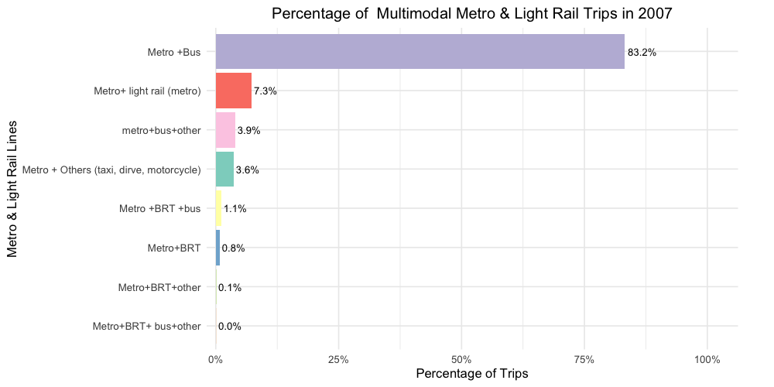
Single-trip Metro vs multimodal Metro (2007)
6.13% vs 19.67%

Slide 5
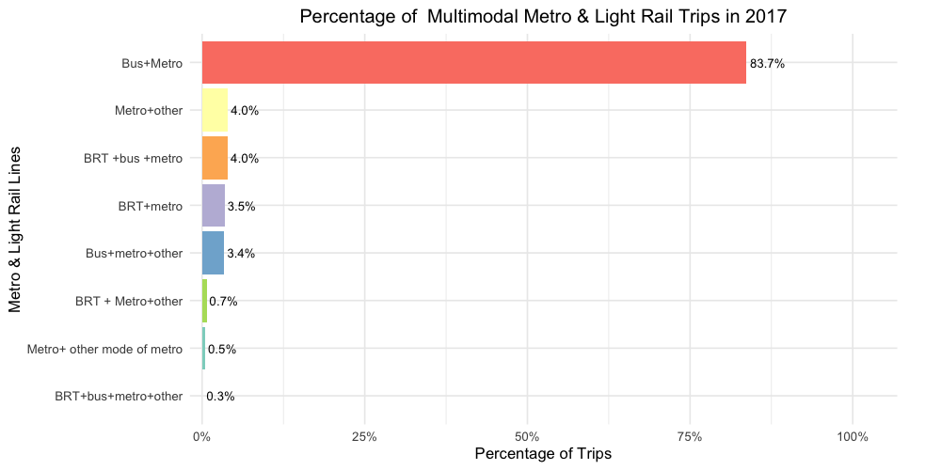
Single-trip Metro vs multimodal Metro (2017)
2.46% vs 10.64%

Slide 6
Metro multimodal trip comparison

Slide 7
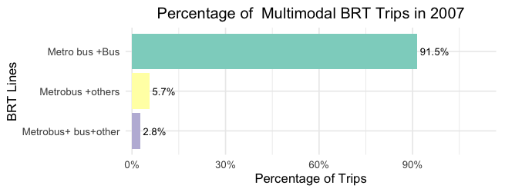
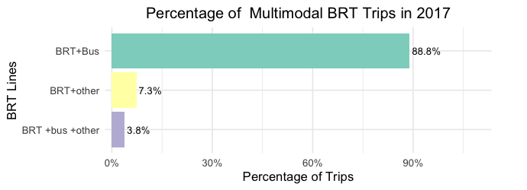
BRT (0.5% vs. 1.1%)

Slide 8
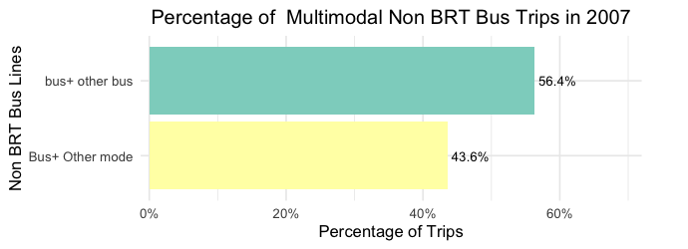
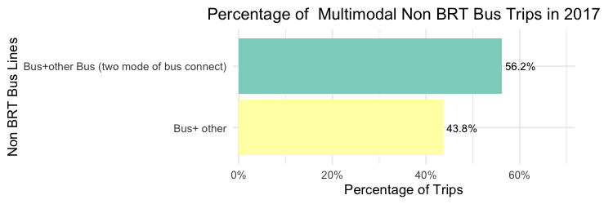
Bus (2.2%vs 1.95%)

Slide 9
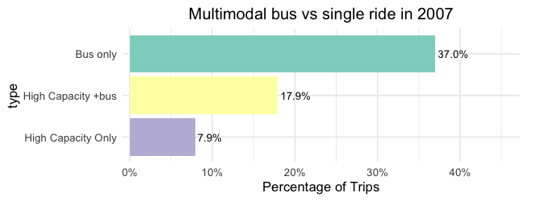
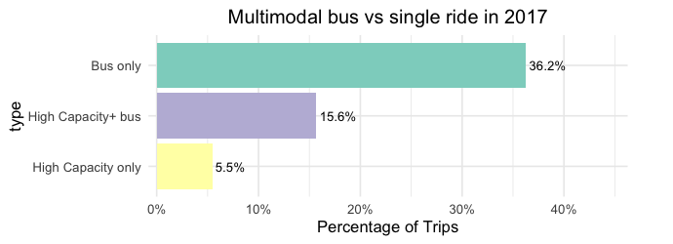
Bus only, High Capacity only, and bus +High Capacity

Slide 10
Weighted trip Analysis
Single-mode trips
76.68% (2007) vs 70.47% (2017, excluding walking)
76.68% (2007) vs 79.25% (2017, including walking)

Slide 11
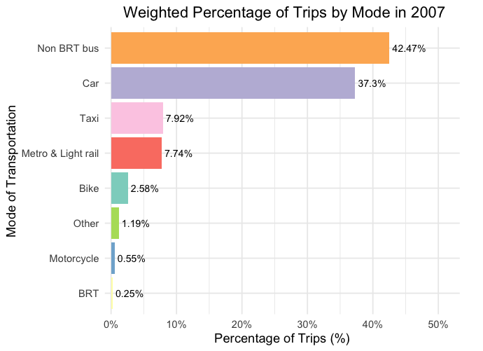
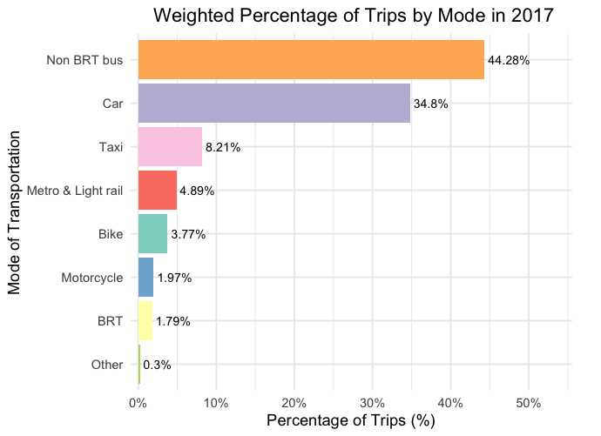
2007 vs 2017 single-mode weighted trip distribution

Slide 12
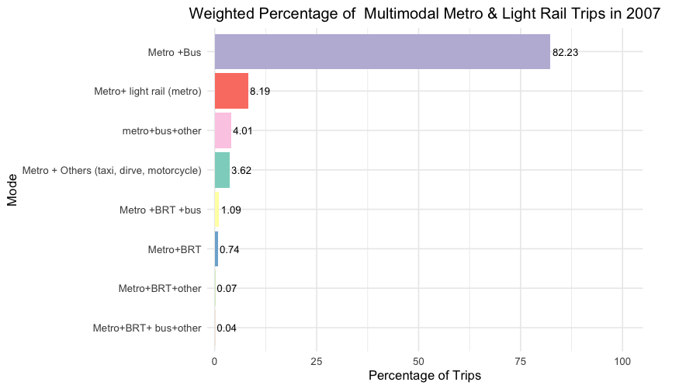
Single-trip Metro vs multimodal Metro (2007)
5.94% vs 19.66%

Slide 13
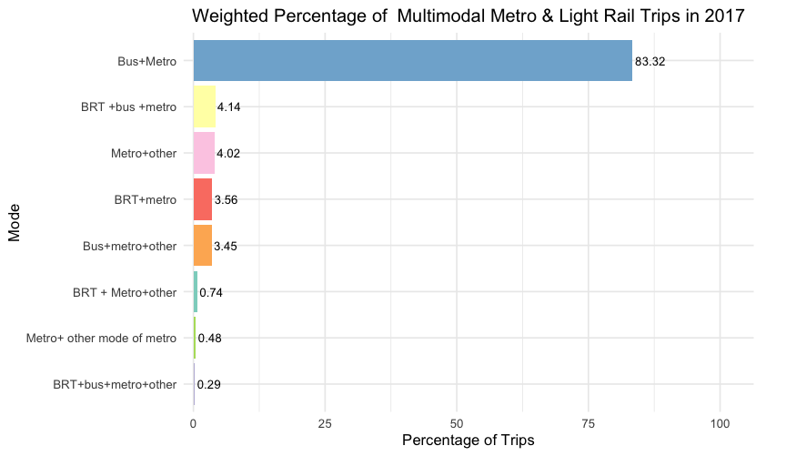
Single-trip Metro vs multimodal Metro (2017)
3.44% vs 22.71%

Slide 14
Metro multimodal trip comparison (weighted)

Slide 15
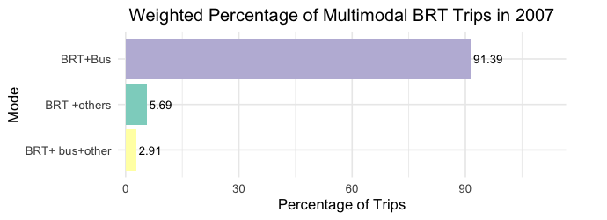
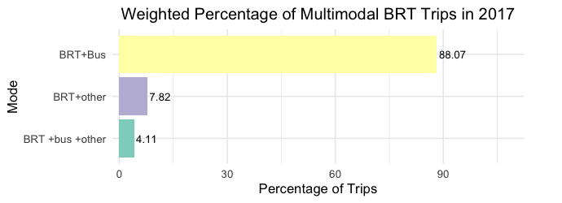
BRT

Slide 16
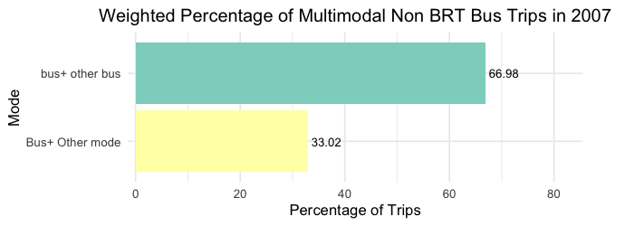
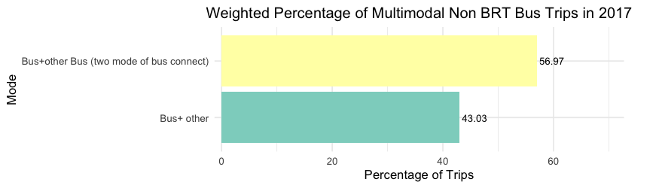
BUS

Slide 17
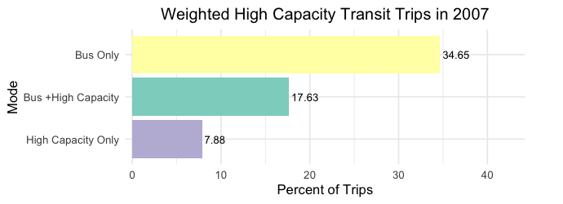
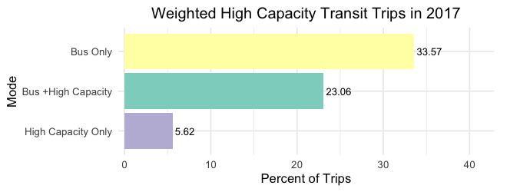
Bus only, High Capacity only, and bus +High Capacity

Slide 18
Mexico City

Slide 19
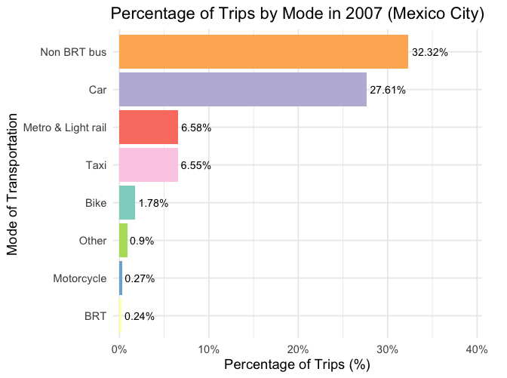
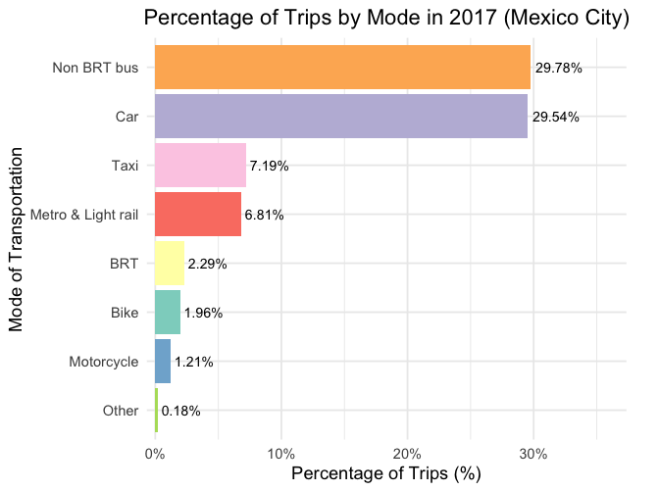
2007 vs 2017 single-trip distribution

Slide 20
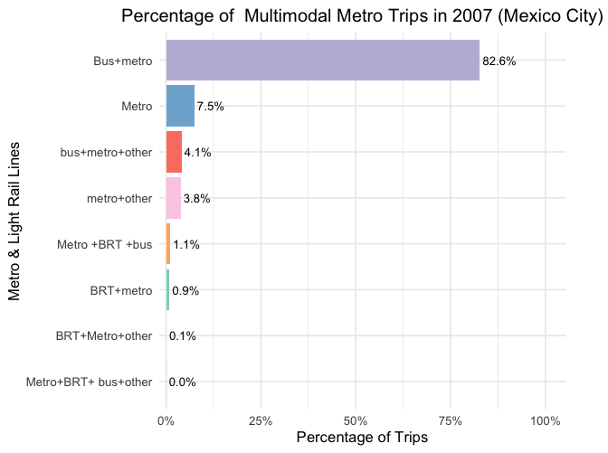
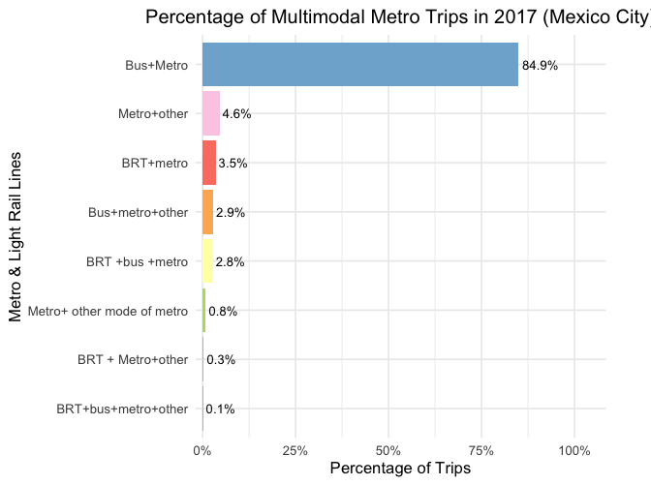
Metro multimodal trip

Slide 21
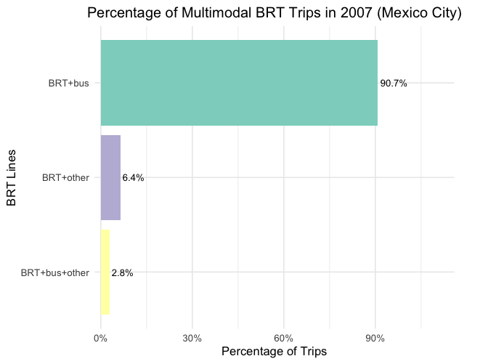
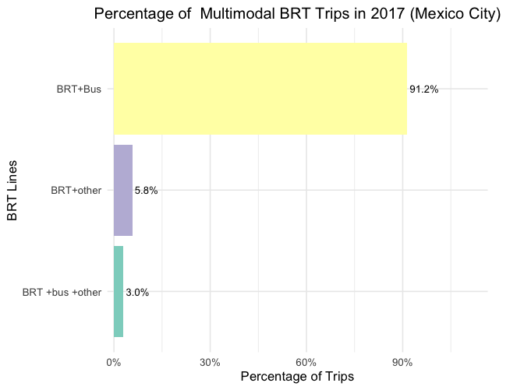
BRT Multimodal trip

Slide 22
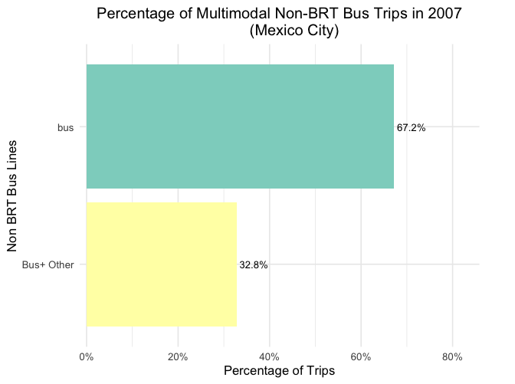
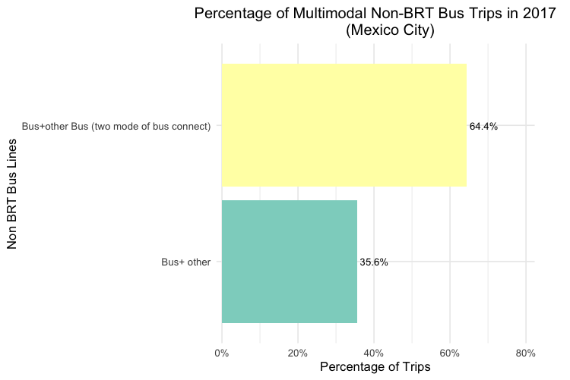
Bus trip

Slide 23
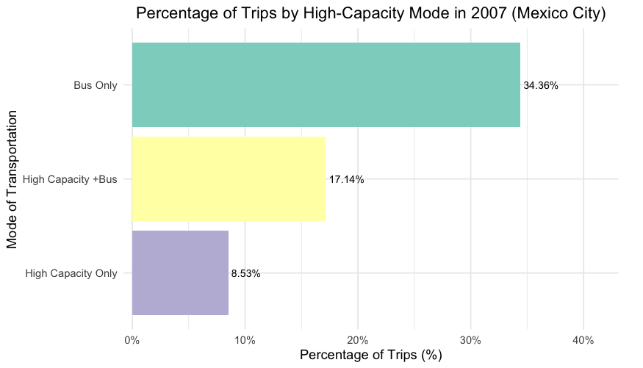
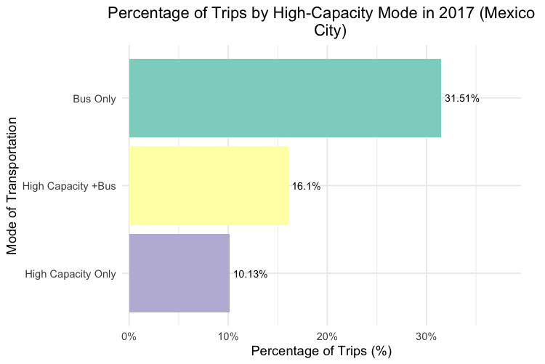
High Capacity vs bus

Slide 24
Out of Mexico City

Slide 25
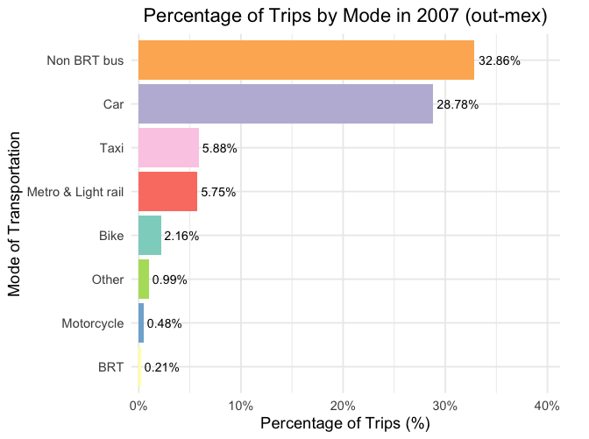
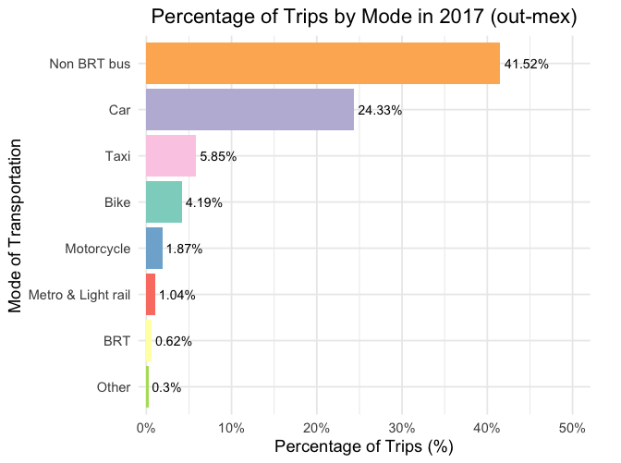
2007 vs 2017 single-trip distribution

Slide 26
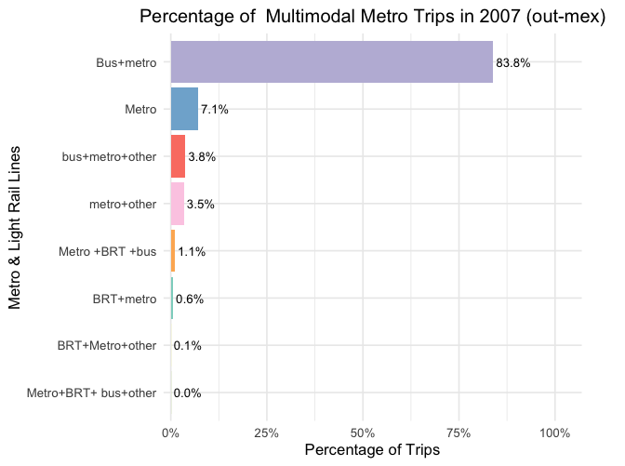
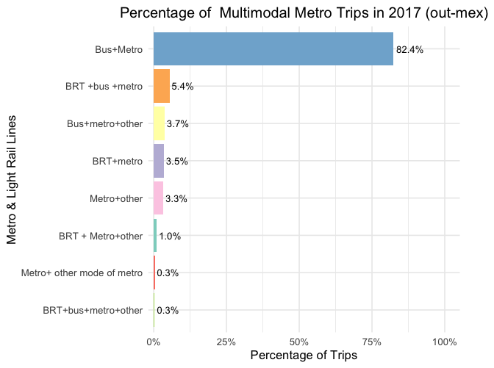
Metro multimodal trip

Slide 27
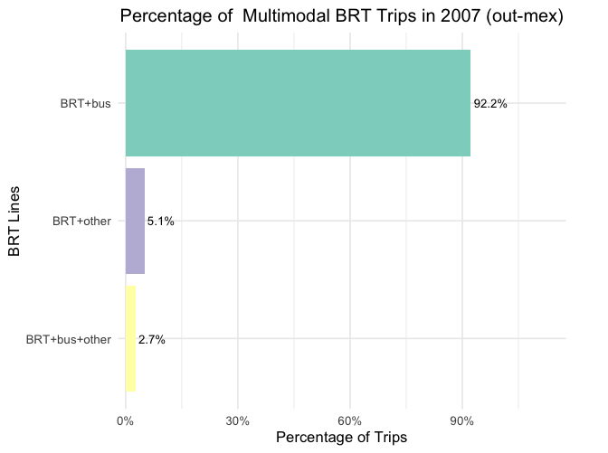
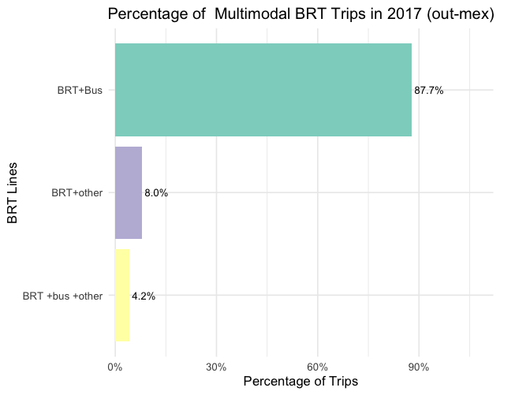
BRT

Slide 28
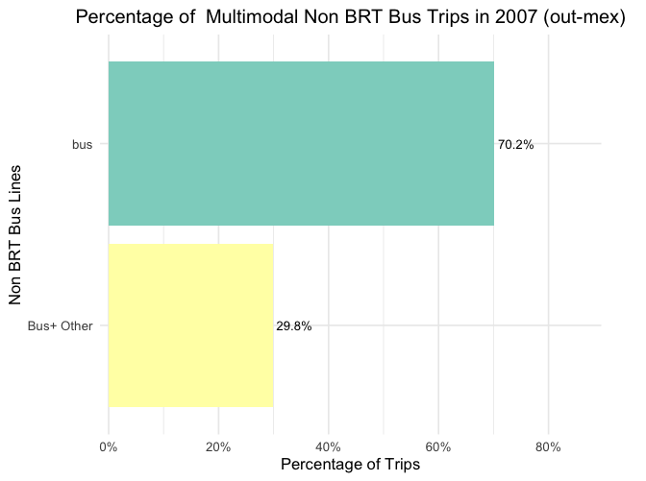
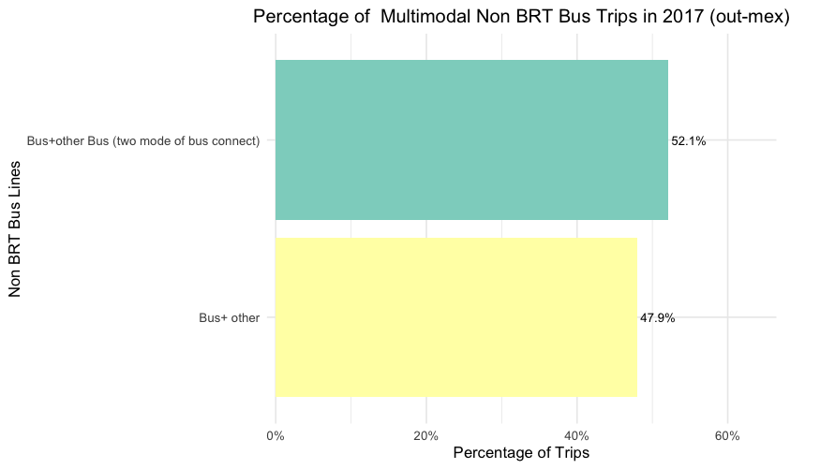
Bus

Slide 29
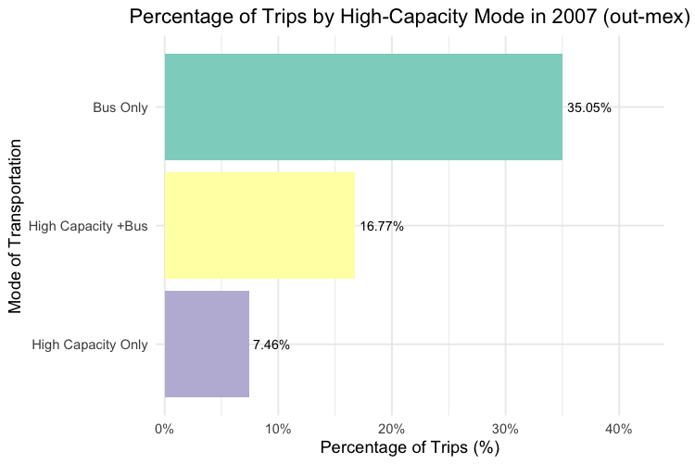
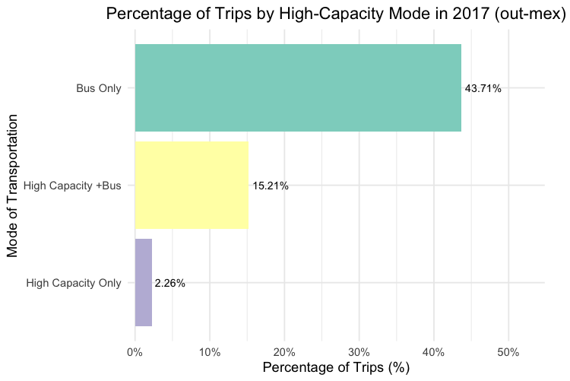
High Capacity

Slide 30
Sampling Examination

Slide 31
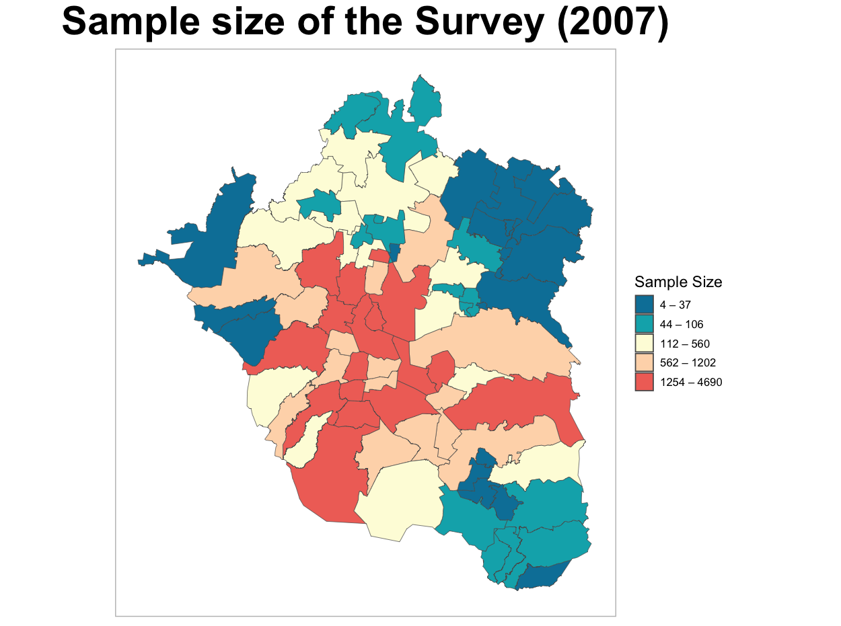
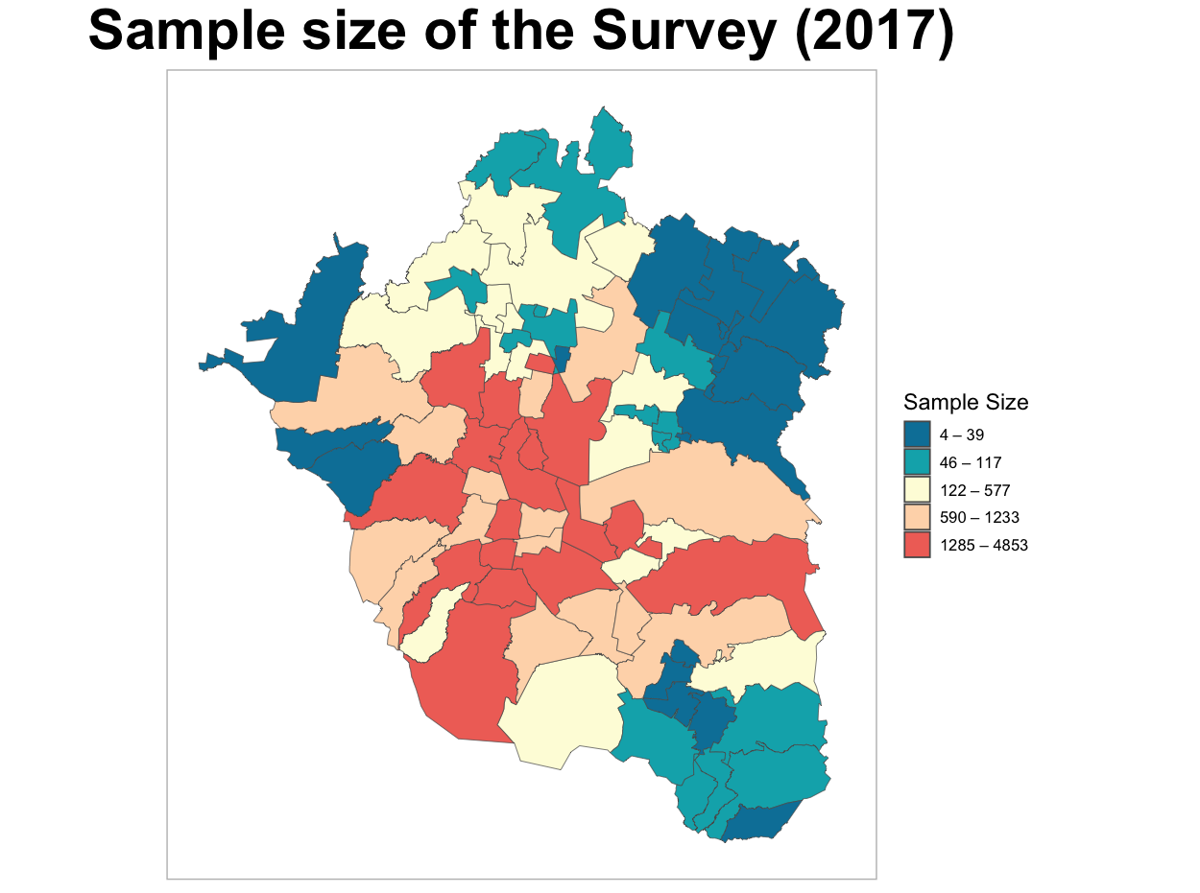
Overall sampling (household based)

Slide 32
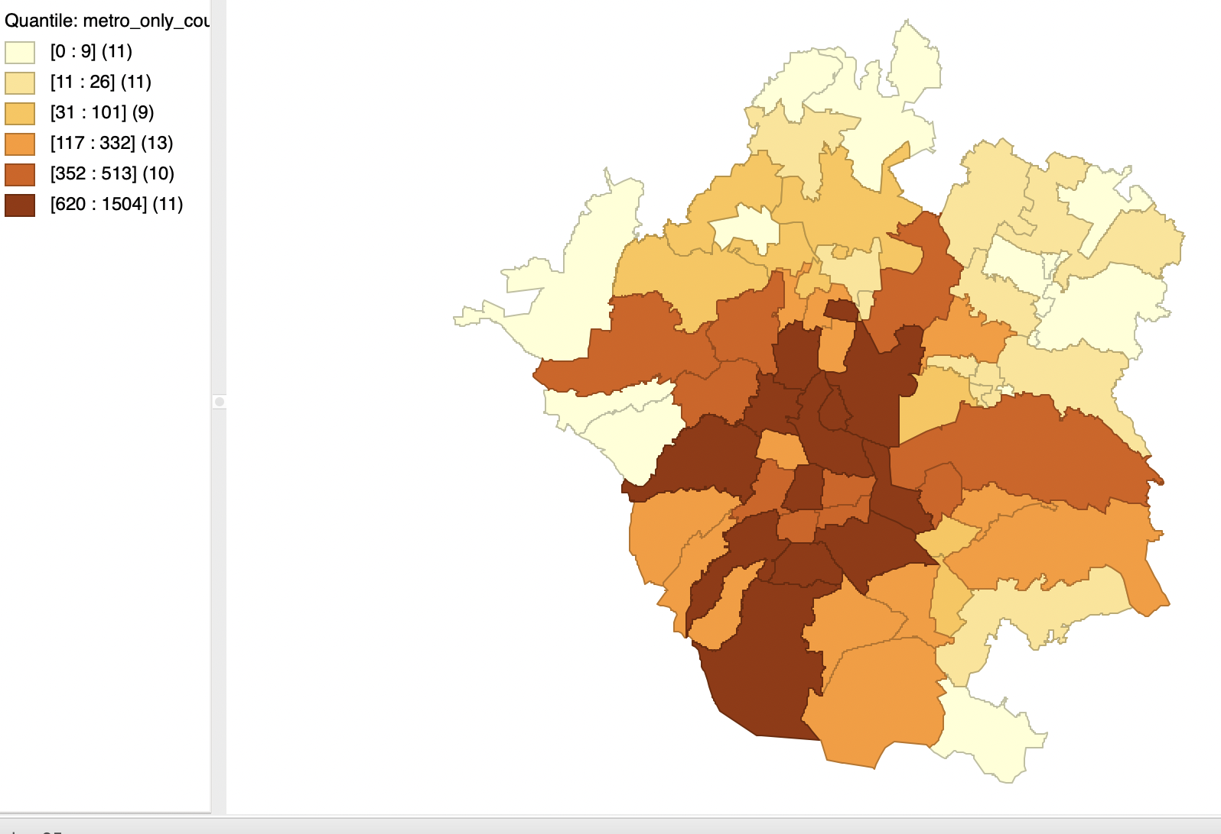
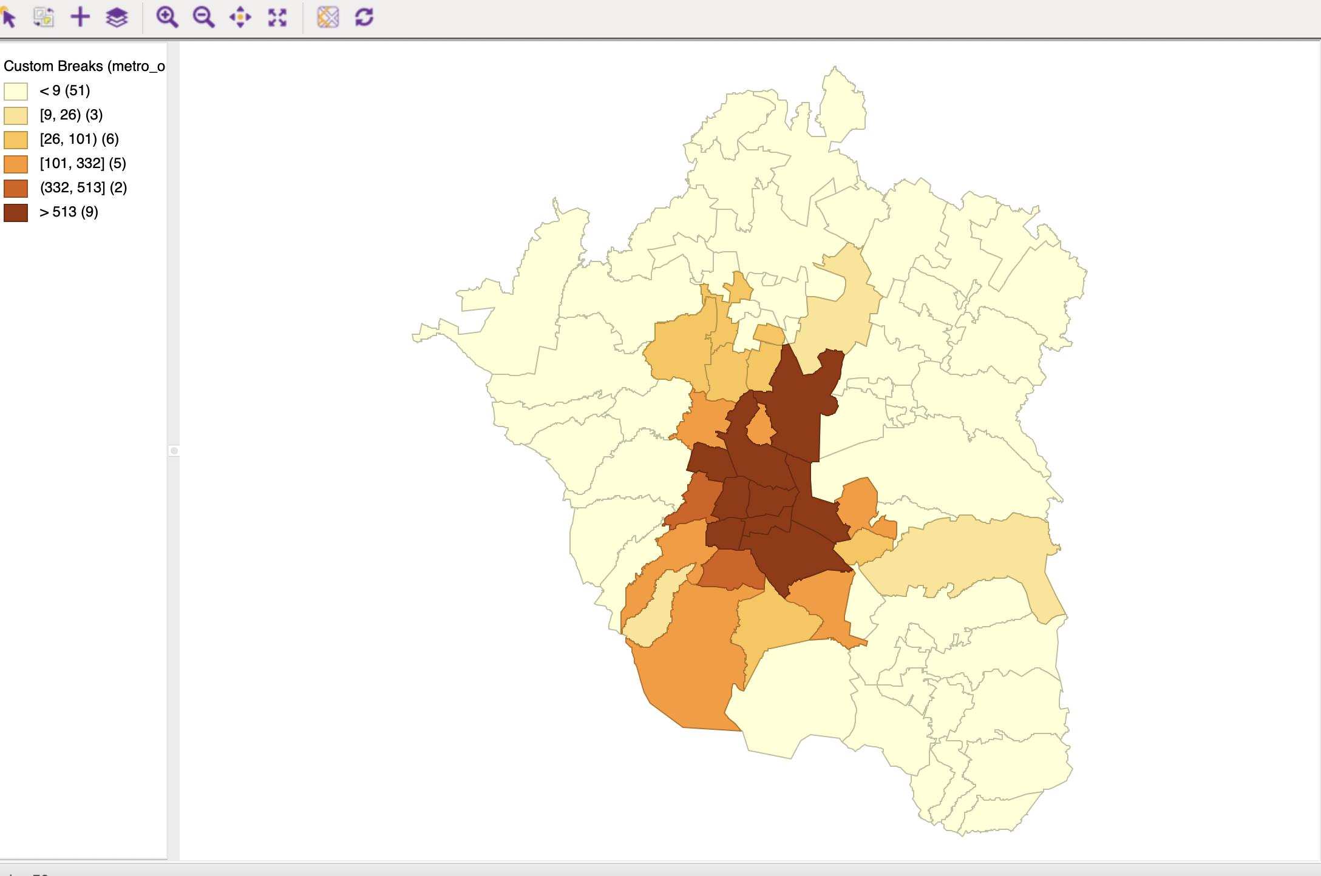
High-Capacity Only Trip Distribution 2007 left, 2017 right

Slide 33
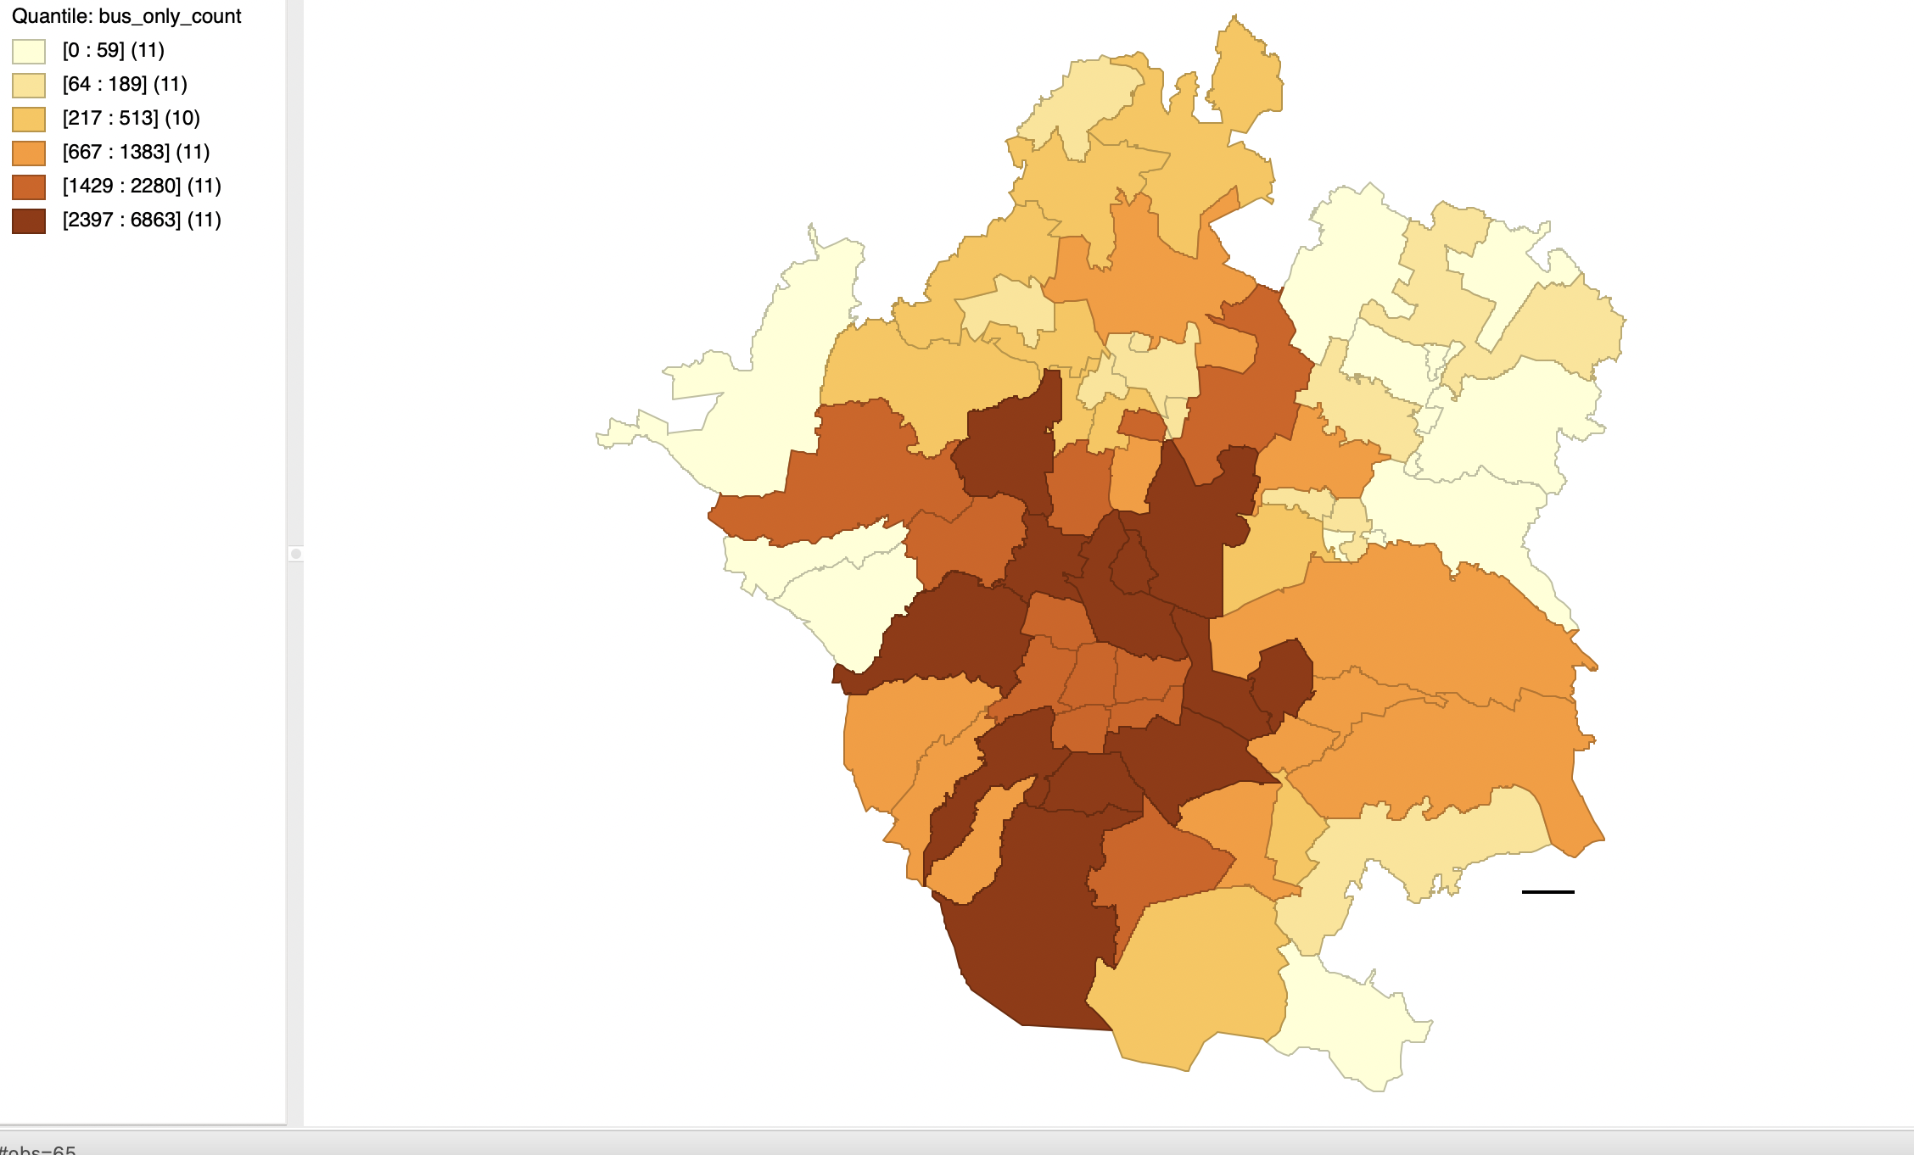
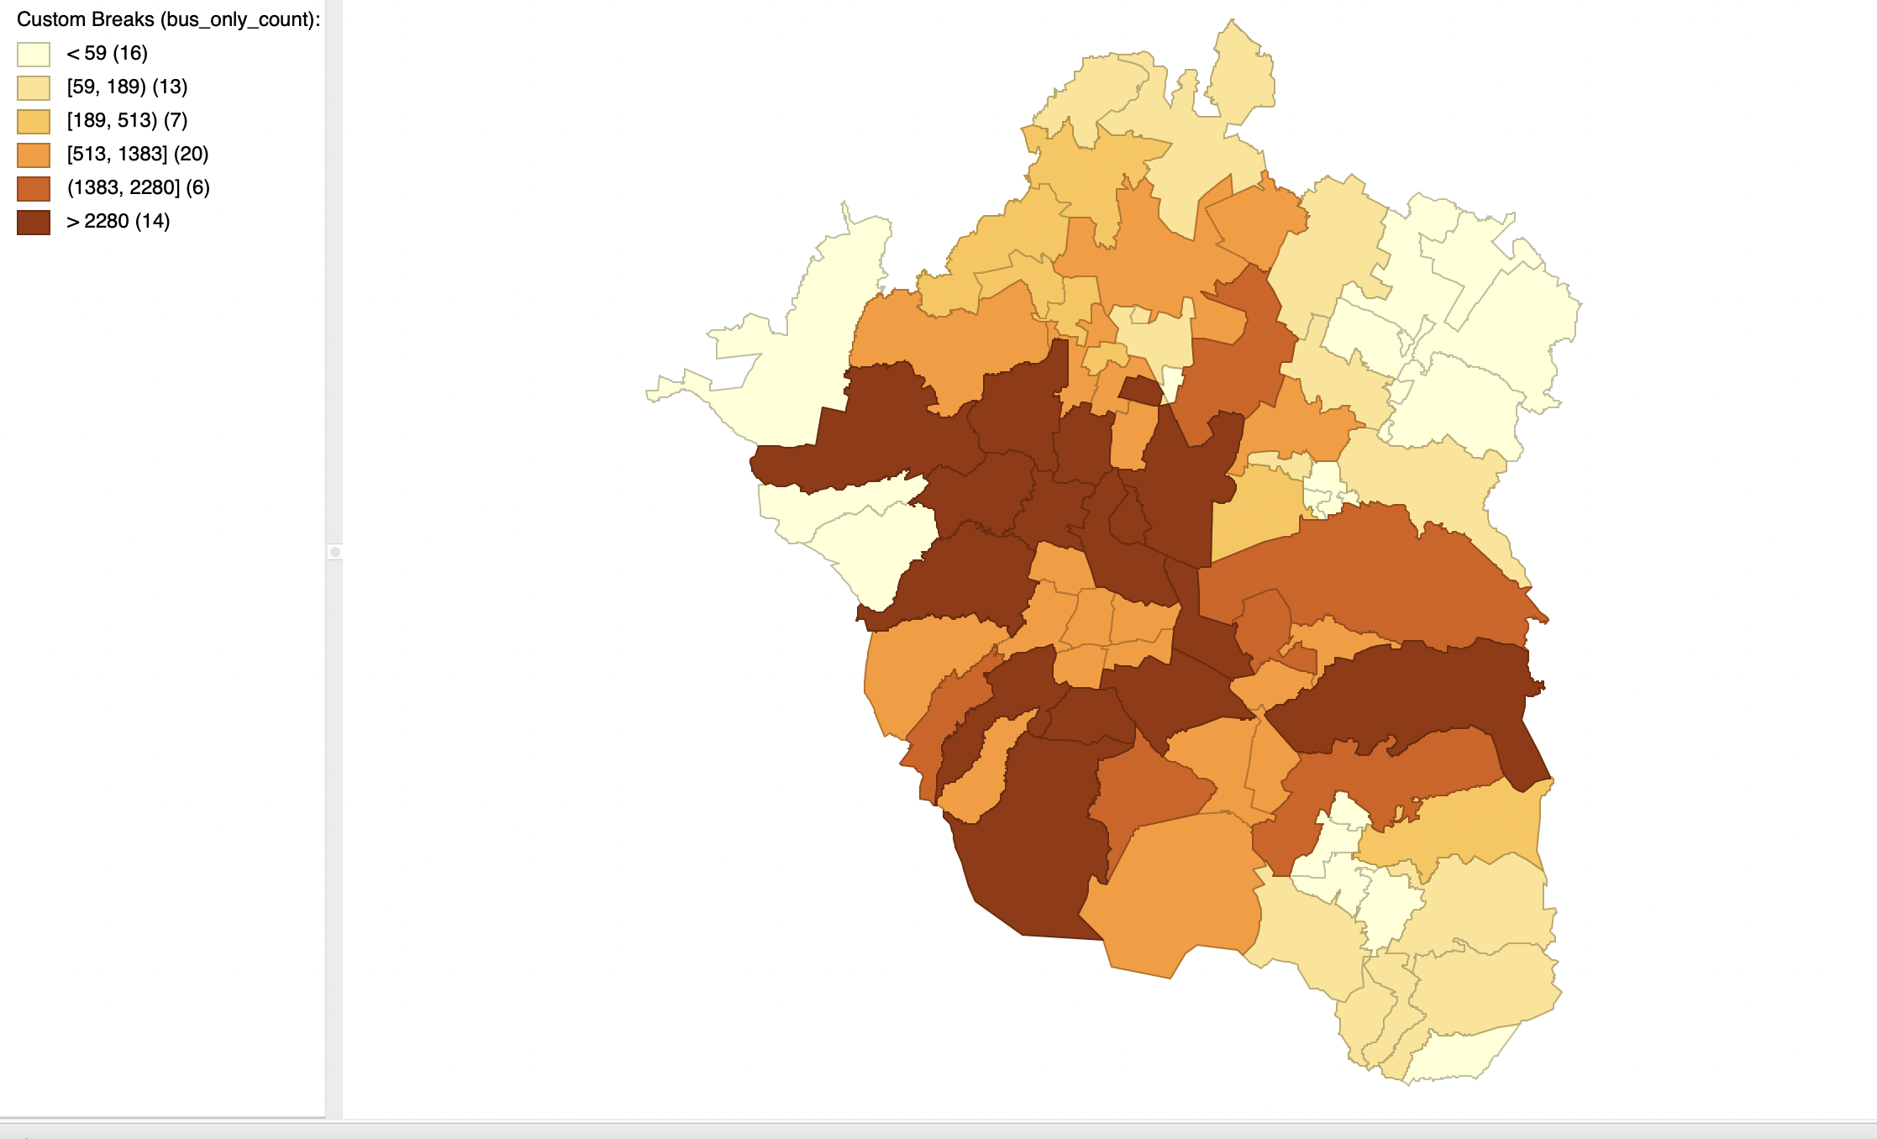
Bus Only Trip Distribution 2007 left, 2017 right

Slide 34
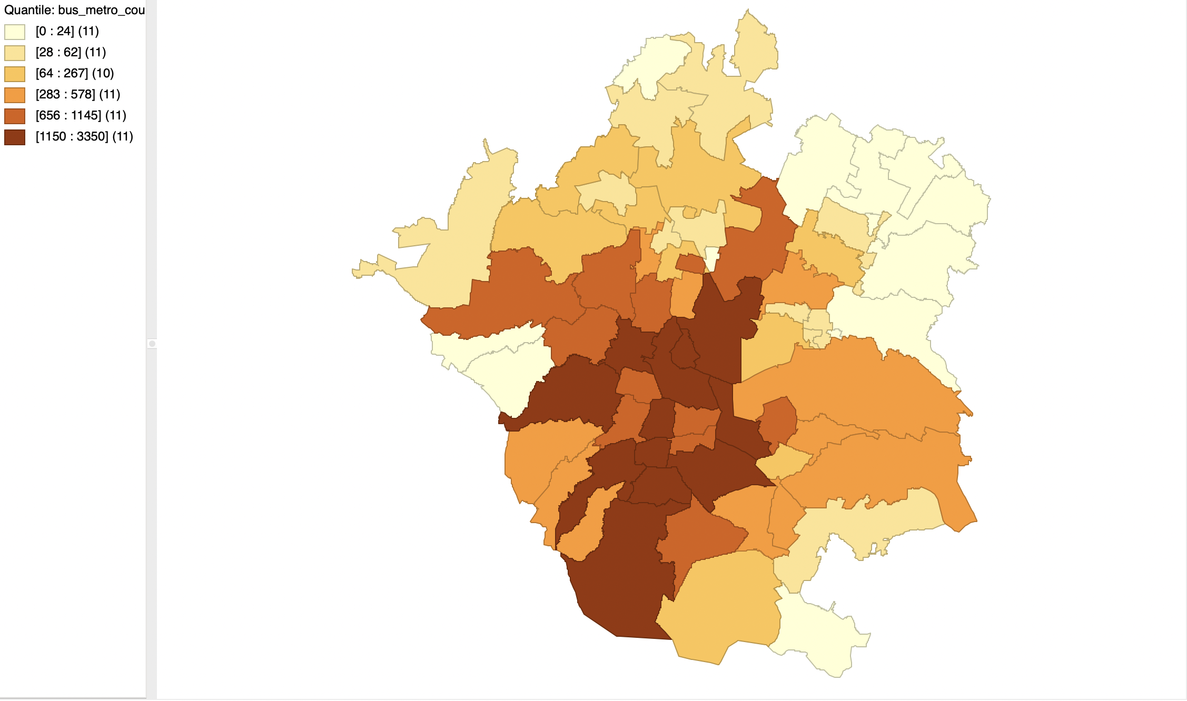
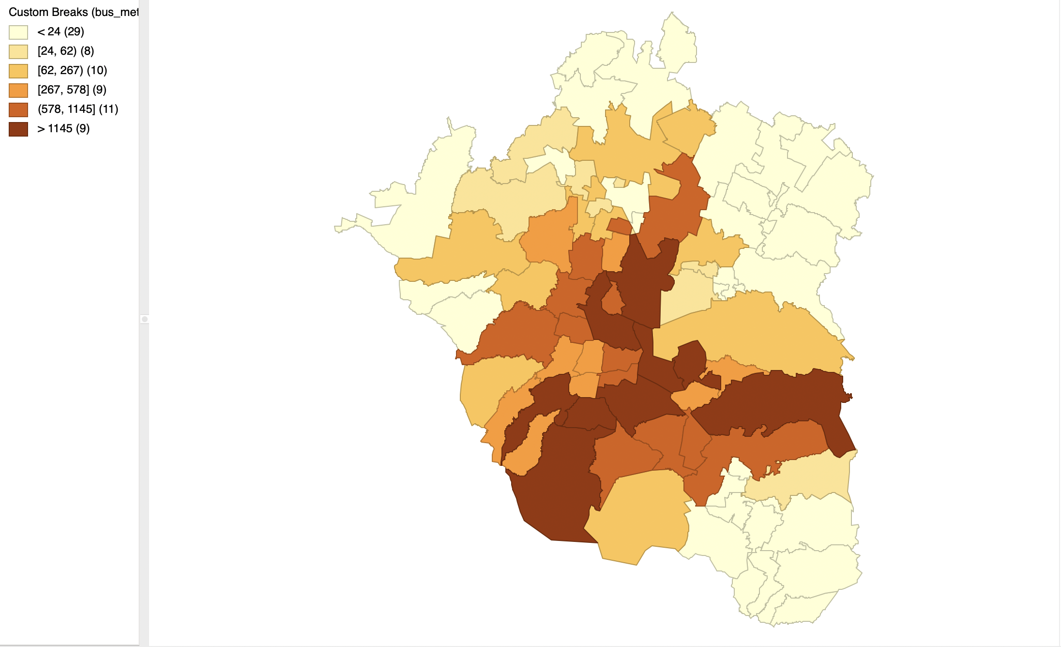
Bus + High-Capacity Trip Distribution 2007 left, 2017 right

